Slide 1



TEKATHON-5.0- 2026
ECDAT | Post-Quantum Migration Platform
• Problem Statement ID: SIH26164
• Problem Statement Title: Enterprise Cryptographic Discovery and Analysis Tool (ECDAT) for Post-Quantum Migration
• Theme: Cyber Security / Space & Defense (NTRO Partnership)
• PS Category: Software Edition | Project: ECDAT
• Live Production Platform: https://sih-edcat.vercel.app
• Core Innovation: AST-Level Crypto Discovery + Mosca Threat Engine + Drop-in NIST FIPS 203/204 Remediation

Slide 2
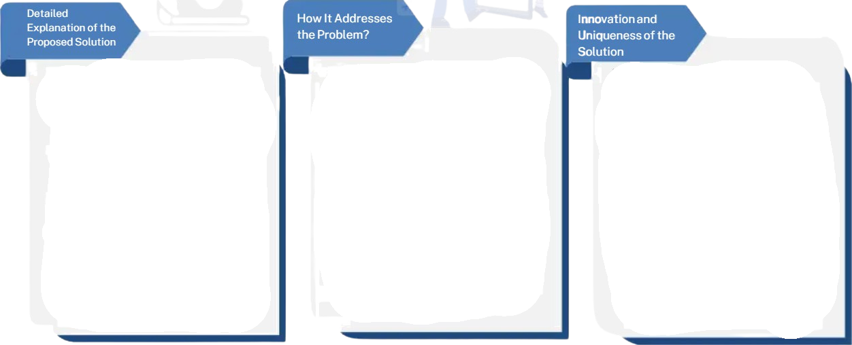
ECDAT
Enterprise Cryptographic Discovery & Analysis Tool
• Automated AST Scanning: Scans multi-language source repositories to discover and catalogue cryptographic assets without regex errors.
• CBOM Generation: Compiles all algorithms, keys, and usages into CycloneDX Cryptographic Bill of Materials.
• Quantum Risk Scoring: Benchmarks primitives against Shor's and Grover's algorithms with automated CVSS scores.
• Export-Ready Compliance: Generates instant CycloneDX JSON and executive PDF audit reports.
• Eliminates Manual Review: Replaces slow, error-prone manual audits with continuous automated CI/CD static scanning.
• Detects Hidden Flaws: Surfaces deprecated ciphers (MD5, SHA-1, DES, RSA-1024) buried deep in legacy dependency trees.
• Mosca Risk Priority: Calculates migration deadlines using shelf-life X + migration time Y vs quantum threshold Z.
• Actionable Code Fixes: Provides syntax-highlighted, drop-in replacement code for ML-KEM and ML-DSA.
• True AST Parsing: Abstract Syntax Tree inspection eliminates false positives that plague simple keyword matching.
• Drop-in NIST Standards: Direct synthesis of FIPS 203 (ML-KEM-768) and FIPS 204 (ML-DSA-65) code snippets.
• Polyglot Coverage: Inspects Python, Java, C/C++, and Go in a unified enterprise posture console.
• Audit Interoperability: 100% compliant with NIST PQC Guidelines and CycloneDX 1.6 specifications.
@TEKATHON-4.0- Template
2

Slide 3
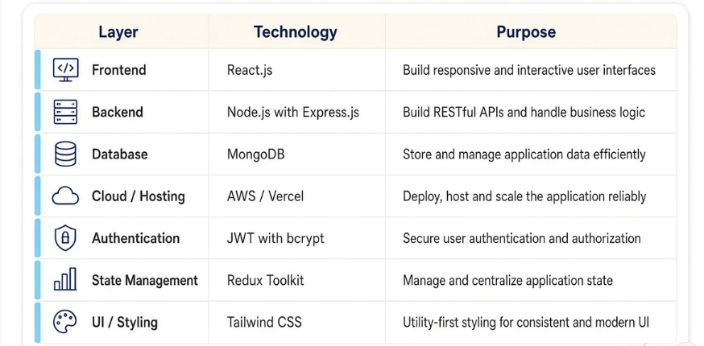
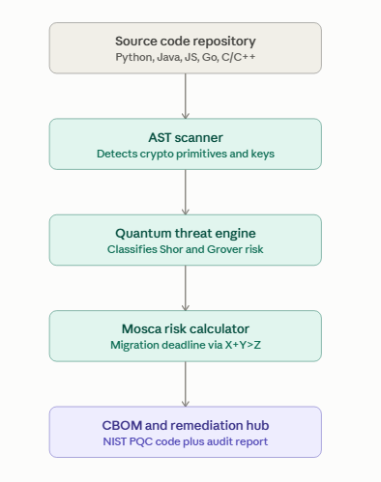
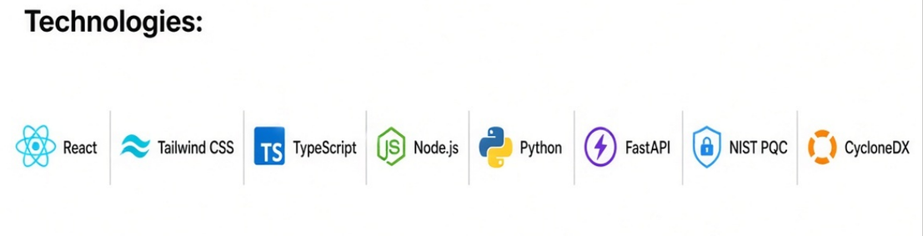
TECHNICAL APPROACH
Technical flow:
Technologies:
@TTEEKKAATTHHOONN--34..00--TTeemmppllaattee
3

Slide 4
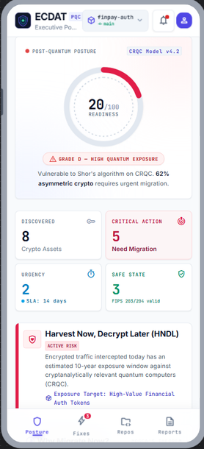
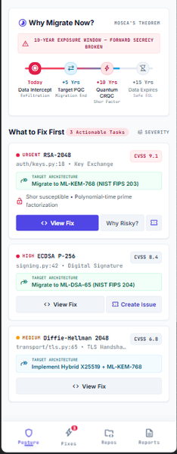


FEASIBILITY AND VIABILITY
OUR APP ECDAT UI
CHALLENGES VS OUR APPROACH
01
Mixed & legacy codebases
Polyglot AST parsing across Python, Java, C++ & Go
01
02
AST semantic verification with verified call traces
02
Risk of false positive fatigue
03
Uncertain quantum CRQC timeline
Mosca's Inequality X+Y>Z deadline modeling
03
04
Developer resistance to migration
1-Click drop-in code diffs + automated GitHub issues
04
@TEKATHON-43.0-Template
4

Slide 5


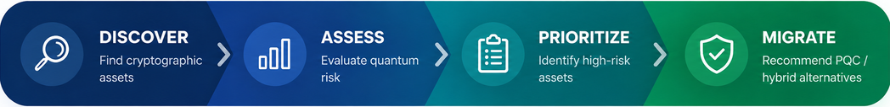
IMPACT AND BENEFITS
Impacts
Benefits
🔐 Cryptographic Asset Visibility
🧠 Automated Discovery Engine
Automated discovery establishes an authoritative, centralized inventory of all enterprise crypto assets.
Reduces audit turnaround from weeks of manual code review to sub-minute automated scans.
🛡️ Proactive Quantum Risk Shield
📋 CycloneDX CBOM Generation
Pinpoints asymmetric assets exposed to Harvest Now, Decrypt Later (HNDL) exploitation.
Provides structured, machine-readable cryptographic bill of materials for regulatory audits.
🚀 Drop-in NIST PQC Code
🚀 PQC Migration Recommendations
📊 Risk-Based Migration Roadmaps
Delivers actionable, copy-pasteable ML-KEM and ML-DSA implementations directly to developers.
Prioritizes high-exposure modules using asset shelf-life, business criticality, and CVSS scores.
🏢 Enterprise-Wide Compliance
⚡ Accelerated Decision-Making
Transforms complex cryptographic mathematics into clear executive risk scores and remediation SLAs.
Unified visibility across microservices, cloud deployments, and mission-critical databases.
@TEKATHON-43.0-Template
5

Slide 6

RESEARCH AND REFERENCES
Sources
NIST — Post-Quantum Cryptography (PQC) Standards (2024)
LIVE PROTOTYPE
• FIPS 203 (ML-KEM) — Module-Lattice-Based Key-Encapsulation Mechanism
• FIPS 204 (ML-DSA) — Module-Lattice-Based Digital Signature Standard
• FIPS 205 (SLH-DSA) — Stateless Hash-Based Digital Signature Standard
sih-edcat.vercel.app
Mosca's Theorem — Quantum Migration Horizon
Working demo of the classification dashboard, GIS overlay and alert feed.
• Michele Mosca: Cybersecurity in an Era with Quantum Computers (X + Y > Z Equation)
• Establishes formal inequality for migration urgency vs shelf-life
Cryptography Bill of Materials (CBOM) Standard
• OWASP CycloneDX v1.6 CBOM Specification for cryptographic asset inventory
• Standardized schema for cryptographic primitives, dependencies and key sizes
Team:
Harvest Now, Decrypt Later (HNDL) Threat Vector
Problem Statement ID: SIH26162
Theme: Disaster management
• National Security Agency (NSA) & CISA Post-Quantum Migration Directives
• Immediate defense required for long-shelf-life sensitive data
Live Operational Prototype & Open Source Repository
• Live Working Platform: https://sih-edcat.vercel.app
• GitHub Repository: https://github.com/PaliiiXRAY/sih-ecdat
@TEKATHON-43.0-Template
6

